Slide 1

Meet the Teacher
Welcome to Reception
Mrs Mills

Slide 2

Questions
Welcome to Reception ☺
If you have any questions, we will answer them at the end of the session.

Slide 3
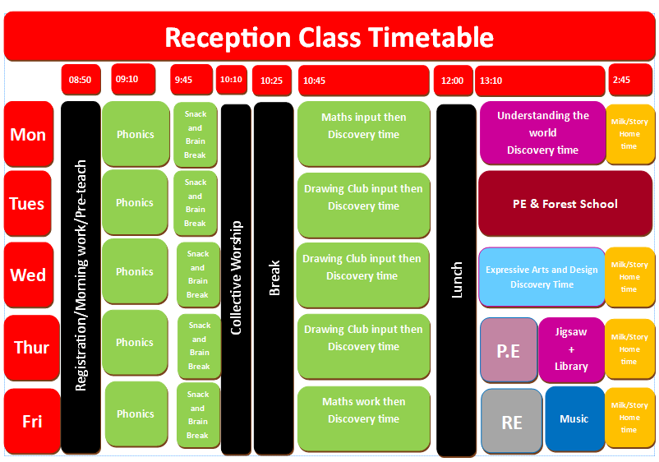

Slide 4

Class Teacher:
Mrs Mills
Teaching Assistant:
Miss Daly (Mon – Fri)
Mrs Russel in Miss Daly’s absence

Slide 5
PE
Tuesday & Thursday
Children must wear their PE kits to school on PE days.
Some sessions will be outside, so make sure they have appropriate kit on.

Slide 6
General
Water only in water bottles.
Long hair tied back.
Urgent messages to the office.
Speak to us at the end of the day not at drop off.
Wave at us when your child is at the front of the line.

Slide 7
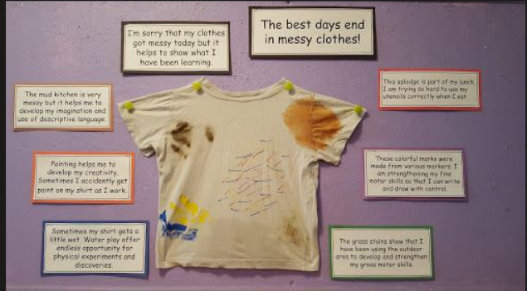
Reuse stained shirts or buy second hand

Slide 8
Reading books and records
Reading books are matched to your child’s phonetical knowledge. Reading books and records will be collected in on a Thursday and sent home on a Friday.
Please listen to your child read 3 times per week and comment/sign in their reading record. Please make sure your child brings in their reading book and record with them everyday.
We would love to have some parent readers to come and read with our children once a week on a Thursday.

Slide 9
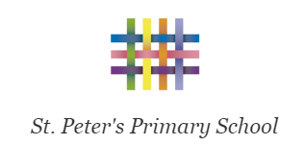
Tapestry
Children in Reception will have their activities recorded and published on Tapestry – an online Learning Journal.
We will publish to individual accounts and whole class pieces when appropriate.
If you have any issues logging into Tapestry please let us know.

Slide 10

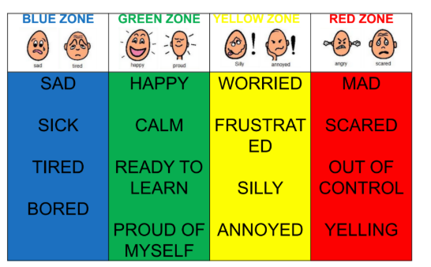
Zones of Regulation
All zones and emotions are ok!

Slide 11

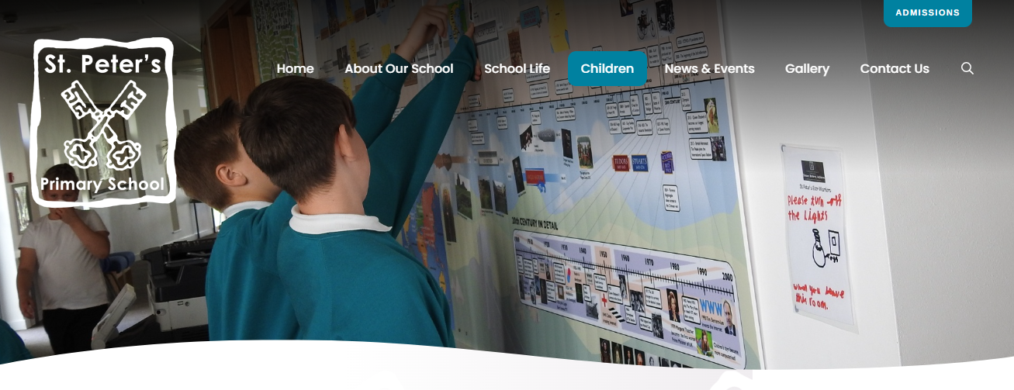

School News App
Website and School News App
Please regularly check our class page on the school website for any important information and news. Most information is also available through the School News app which can be downloaded onto both Apple and Android phones.

Slide 12
Online safety is a shared responsibility!
At School:
At home:
We need you to reinforce what is being taught at school, know what applications are age appropriate and closely monitor your child’s use of the internet.
We teach the children how to be safe online, how to use the internet responsibly and closely monitor their use.

Slide 13







Instagram
Tik Tok
Snapchat
Musical.ly
All of these applications have age limits!
Children must be 13 years old to use them!
WhatsApp
YouTube
Fortnite

Slide 14

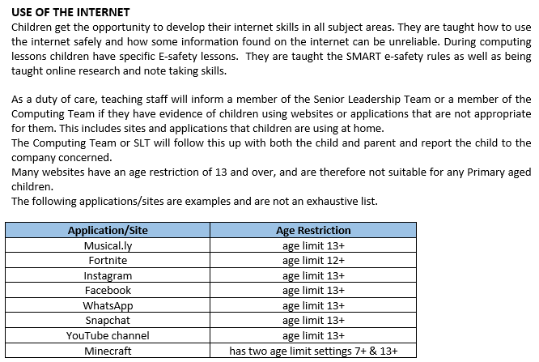
School Policy
There is a clear section in our Computing policy that addresses use of the internet.

Slide 15


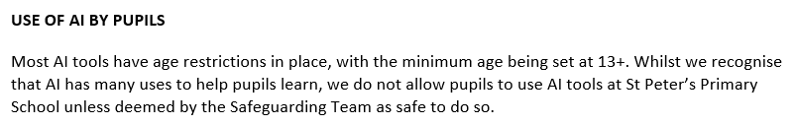
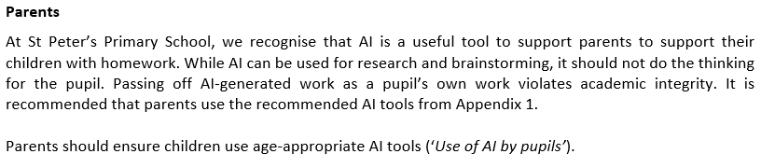
Use of AI
There is a clear section in our AI policy that addresses use of AI by both children and parents.

Slide 16
What is the Universal Offer?
At St Peter’s Primary School, we are committed to offering an inclusive curriculum to all our pupils, whatever their needs or abilities. We aim to ensure that all our learners have access to a broad and balanced curriculum, supporting the development of the whole child.
We recognise that children are individuals who learn in different ways, and that some children need additional differentiated approaches beyond what is normally provided as part of quality first teaching in our classrooms. Some children need additional support because:
. They have a significantly greater difficulty in learning than the majority of children of the same age.
. They have a disability as defined under the Equality Act, affecting their ability to access and benefit from the educational opportunities generally enjoyed by children of the same age.
The Special Education Needs Co-Ordinator/ Deputy Designated Safeguarding Lead at St Peter’s is Miss Sarah McKenzie. You can find our full Local Offer on our school website.

Slide 17
So what support is available for my child?
Curriculum design
St Peter’s pedagogy ‘I do, We do’ You do’
Flashback 4s and 4 from before
Scaffolds and writing frames to support learning
Small steps teaching in mathematics/ Steps to Success
Text marking
Flexible groupings and Adult support
Working walls
Use of visualiser
Manipulative and resources
Word Banks and Sound mats
Talking tins
Use of personalised dictionaries
Highlighted lines and Scribing
Use of laptop to record learning
Use of widget
Use of Chat GPT (especially translation of documents)
Use of Google classrooms to record learning

Slide 18
So what support is available for my child?
Cwtchy Corner (Sensory Room) and The Nest
Forest Schools
Wobble cushions and Wobble boards
Fidget toys
Regulation stations
Dark Tent
Weighted blankets
Brain breaks
Movement breaks
Theraputty and Therabands
Manipulatives
Chewy toys
Adapted resources: squeezy scissors, triangular pencils
Pencil grips and Handwriting warm-ups
Sensory circuits

Slide 19
Next Steps
If your child is still struggling to access the curriculum, whether this is due to their academic, social, well-being, physical or sensory needs, additional support may be required. This would first be SEND School Support (such as accessing an intervention) and then if needed, a referral to an outside agency. A written plan provided by the school may also be required (Support Plan)
Interventions
Phonics/ Spelling/ Math interventions, Early morning readers, Social groups, Guided reading interventions, Emotional Literacy Support (ELSA), Precision teaching, fine motor skills groups, mentoring and support from our Education Mental Health Practitioner.
Referrals:
NHS Speech and Language team, Occupational Therapy, Primary Mental Health Support Team, Educational Psychologist, School Nurse, Children and Adolescence Mental Health Services
EHCP
If it is felt that, despite receiving rigorous intervention provision, and where the school has taken relevant and purposeful action to identify, assess and meet the needs of a SEND child, that the child is still not making expected progress, the school or parents could make a request to make an EHCP needs assessment (EHCna). An assessment takes place over a twenty-week period. Following a needs assessment is agreed at panel and initiated, the process of providing an EHCP can start. After consultation between the Local authority’s 0-25 team, other educational professionals, the school and parents, a plan may be given to a child that can run from anytime between the ages of 0 to 25.

Slide 20
Attendance
Attendance is most important to ensure that all children achieve their full potential and make the most of their time at school.
Punctuality is also crucial to ensure children have the maximum time in school and do not miss vital starts to lessons each day.

Slide 21
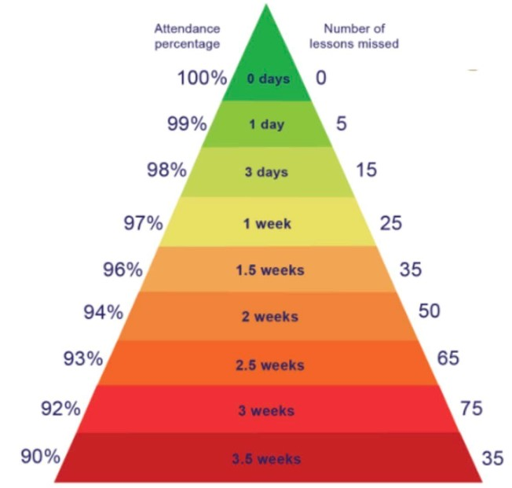
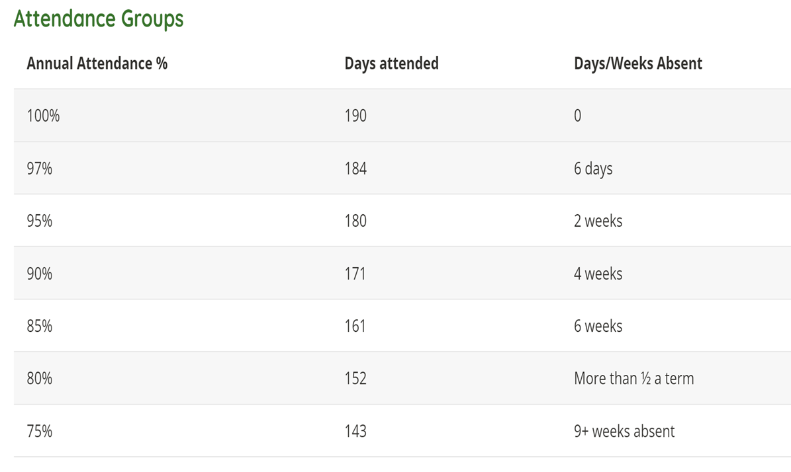
These images show the impact on percentage of days missed throughout the year and the number of lessons of learning missed.

Slide 22
From 19 August new DFE government attendance guidance and policy came into force. Once governors have approved the new policy for the school this will be shared with parents.
However, the main points are these:
- new rules regarding term time absence and fines for term time
holidays.
new rules regarding expectations on attendance by parents and engagement with school processes.
new procedures by school to begin discussions regarding attendance straight away.

Slide 23
New fines rules
Who may be fined?
Penalty notices may be issued to each parent who allows their child to be absent from school. However, they should usually only be issued to the parent or parents who have allowed the absence (regardless of which parent has applied for a leave of absence).
Penalty Notices can be issued when there have been 10 unauthorised absences (1 school day = 2 sessions, 5 school days = 10 sessions). The threshold can be met with any combination of unauthorised absence within 10 school weeks. Penalty Notices are issued for any term-time or irregular absences that are unauthorised (for example, a 5-day term-time holiday) - whether these absences are taken consecutively or cumulatively over a period of 10 school weeks.

Slide 24

If you are struggling, please come and see us.

Slide 26
We will continue to engage with parents and children when attendance falls below expectations through letters, discussions, meetings and if required referrals to the Education Welfare Officer (EWO).
We will continue to expect parents to let us know when children are ill and the 48-hour rule regarding sickness and diarrhoea apply.
We will ring parents if we have not heard from them if the children are in school on the first day and then every other subsequent day until they return unless parents ring school to update.

Slide 27
Parents should expect to be prepared to discuss any attendance issues with their child’s class teacher whenever necessary, at parents evenings and informal meetings.
Either Mr Smith or Mr BM will meet with parents and children when attendance falls below 95% informally initially and then formally when attendance falls below 90%.
ATTENDANCE MEANS ACHIEVEMENT

Slide 28
Any questions?
helen.mills@stpetersprimary.co.uk

