Slide 1
Phonics at st peter’s

Slide 2

Following an update from the Department for Education around phonics teaching we have moved to Essential Letters and Sounds, this is a phonics programme based on Letters and Sounds (2007). This new phonics programme will support your children in making quick progress to become fluent and confident readers.
It is a keep-up, not catch-up system. All children are taught at the same time, with quick interventions happening in the afternoon where needed.

Slide 3
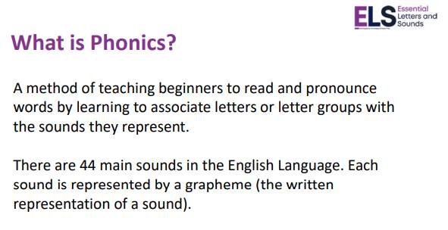

Slide 4
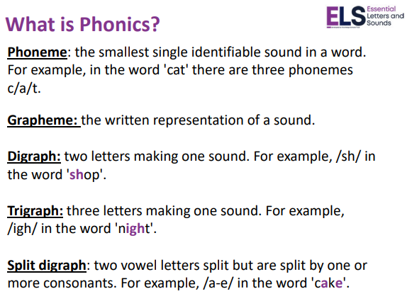

Slide 5
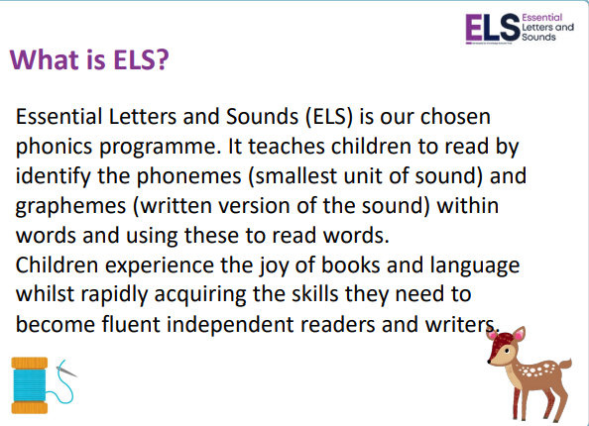

Slide 6
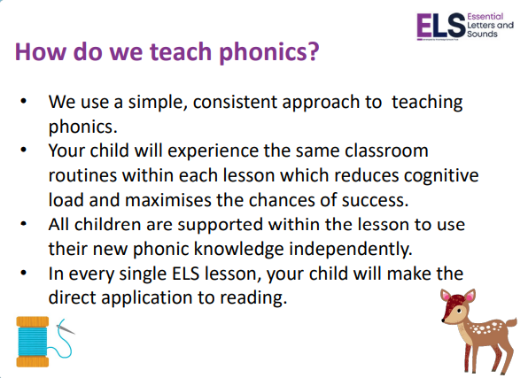

Slide 7
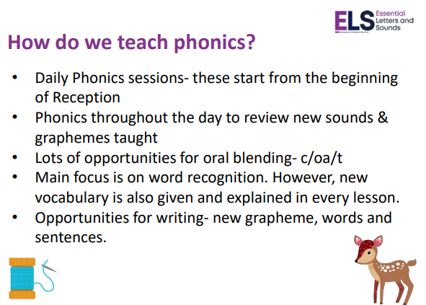

Slide 8
Examples of blending to read
In class we teach children to sound out each word in sequence using a ‘robot arm’ for each sound when each sound has been said we then use blending hands to read the whole word. Let’s try some examples:
Cat
Dog
Tap

Slide 9
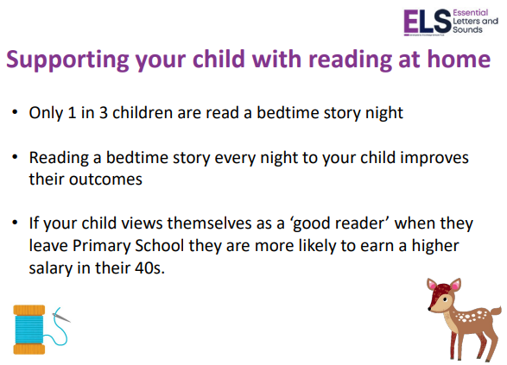

Slide 10
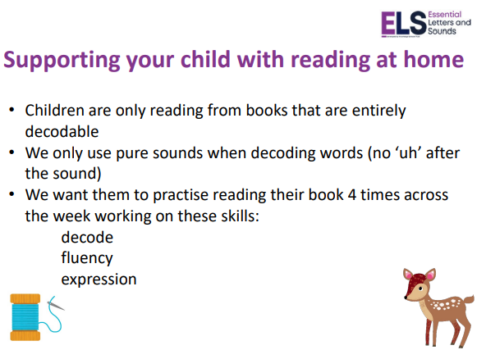

Slide 11
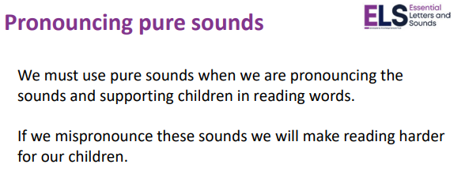

Slide 12
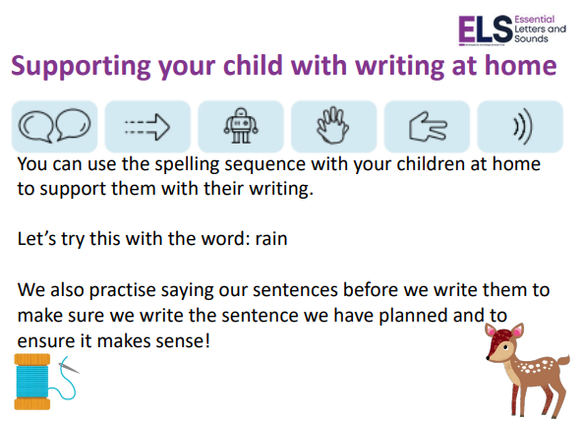
Say, stretch, robot arms, blending hands, phonics fingers and say each sound

Slide 13
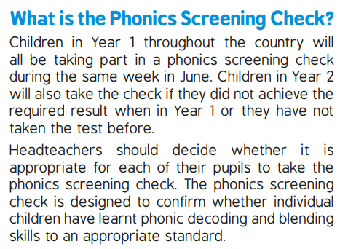
Phonics Screening

