Slide 1
Reception Maths at St Peter’s
Aim:
To understand how maths is taught in Reception
To understand the resources used
End of year goals
How you can support your child with maths

Slide 2
Maths in the Early Years Curriculum
The EYFS curriculum is broken down into seven elements:
Prime areas of learning:
Communication and Language
Personal, Social and Emotional Development
Physical Development
Specific areas of learning:
Maths
Literacy
Understanding the World
Expressive Art and Design

Slide 3
Maths in the Early Years Curriculum
The Characteristics of Effective Learning
Playing & exploring
- children investigate and experience things, and 'have a go'
Active learning
-children concentrate and keep on trying if they encounter difficulties, and enjoy achievements
Creating & thinking critically
- children have and develop their own ideas, make links between ideas, and develop strategies for doing things

Slide 4

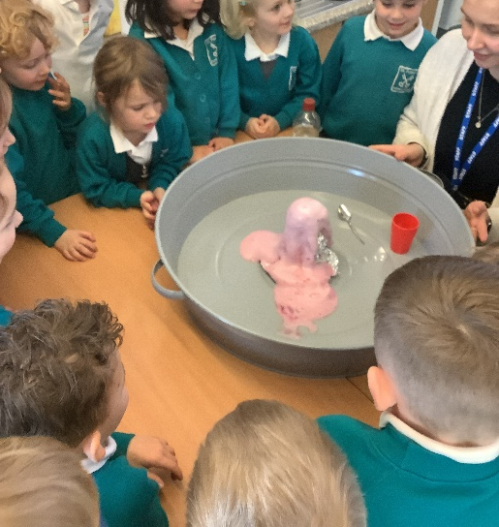
What maths looks like
Maths is fun and part of everyday life.
Maths is taught and learnt through play-based activities.
Maths objectives are taught through child-initiated activities (the child has chosen to do the activity) or adult led activities. These are usually practical activities and take account of the children’s different learning styles.
Cross curricular learning.

Slide 5
What maths looks like
Maths becomes part of daily routines: matching objects when tidying, positional language when tidying (on top of, below etc), ordinal language (first, second etc) in games or lining up…
There are so many opportunities to develop maths in routine activities and structured play.
Problem Solving
Children make their own choices to solve problems (working towards Characteristics of Effective learning). It is an opportunity to challenge themselves and expand their maths thinking.

Slide 6
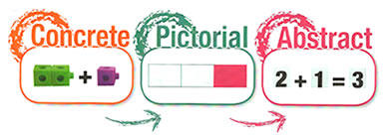
What maths looks like
From Early Years up to KS2 maths is best learnt using concrete objects to act out or represent the maths problem. When ready children progress to using pictures or symbols to visualise or show what they have done and finally they will be able to use the abstract maths which we know as writing calculations (sums). This process allows a child to fully understand the maths they are doing.

Slide 7

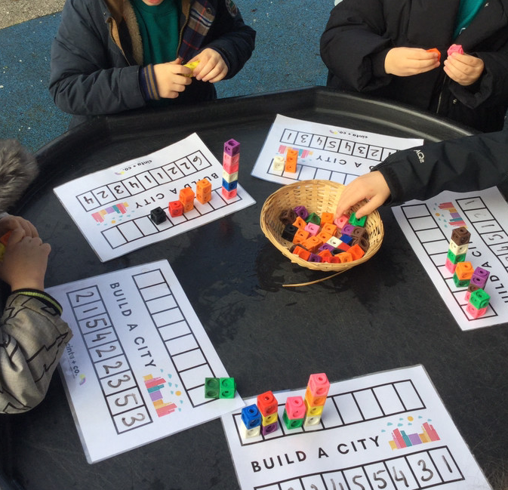
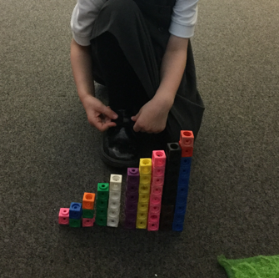

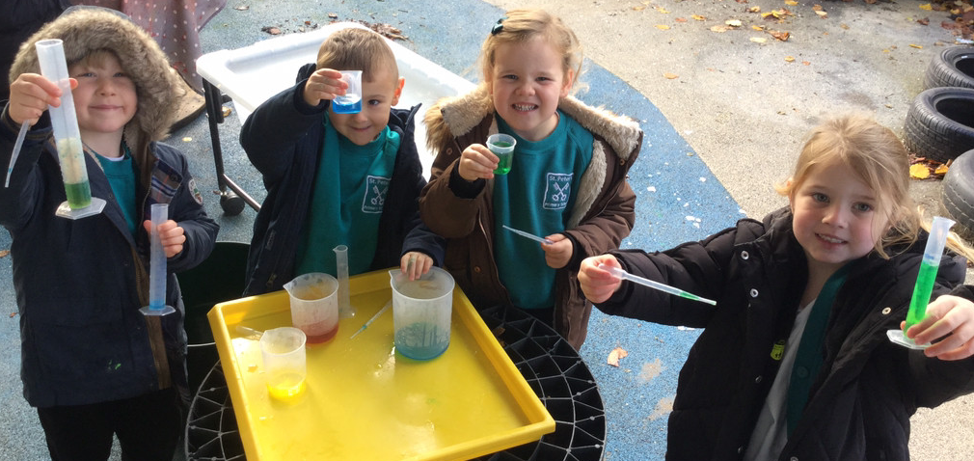
What Maths looks like at St Peter’s
Whole class teaching (a 15-20 minute session, depending on the topic).
Whole class inputs will make use of practical activities, songs and games.
Followed by:
focus group work with an adult (one group working on a related task while other children access the provision.
Objective led planning, adults will work on the specific objectives using whatever elements of the provision the children are currently accessing/enthused by.

Slide 8
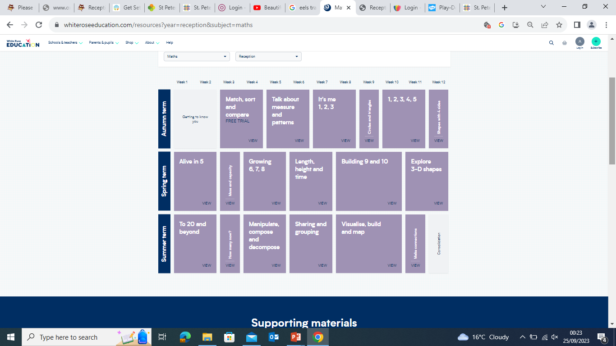

Slide 9
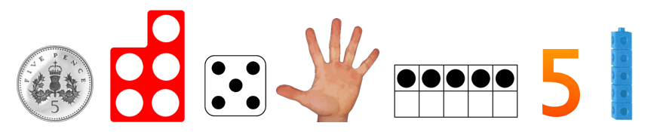
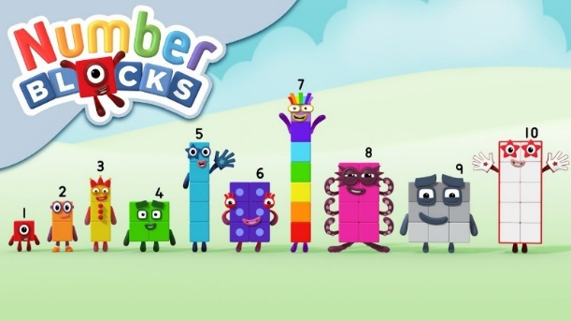
Resources
Anything and everything can be used to support maths learning!
Specific maths equipment:
Numicon, counters, sorting bears, number lines, number cards..
These resources form part of the continuous provision meaning the children can always access them
All the resources in the classroom can be used to support maths, from the building blocks to the baking trays.

Slide 10
End of Year Goals
Number
Children have a deep understanding of the numbers to 10, including the composition of each number. They can subitise (recognise quantities without counting) up to 5. They can automatically recall number bonds to 5 (addition and subtraction) and some number bonds to 10.
Numerical patterns
Children can verbally count beyond 20, recognising the pattern of the counting system. They compare quantities up to 10 in different contexts, recognising when one quantity is greater than, less than or the same as the other quantity. Children explore and represent patterns within numbers up to 10, including evens and odds, double facts and how quantities can be distributed equally.

Slide 11
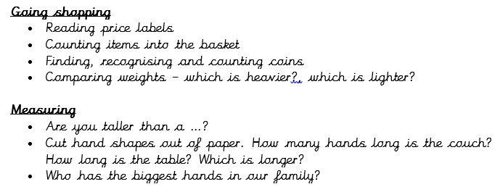
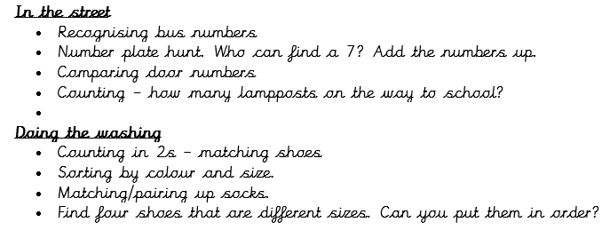
Helping at Home

Slide 12
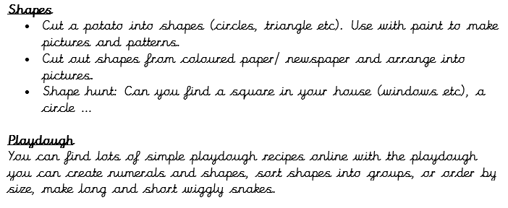
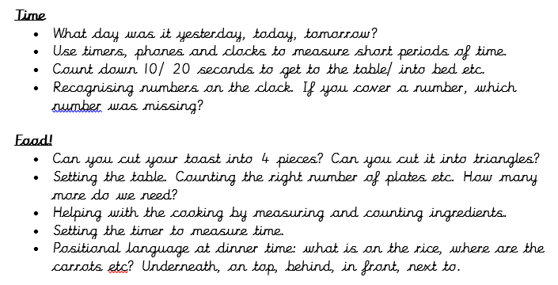
Helping at Home

Slide 13
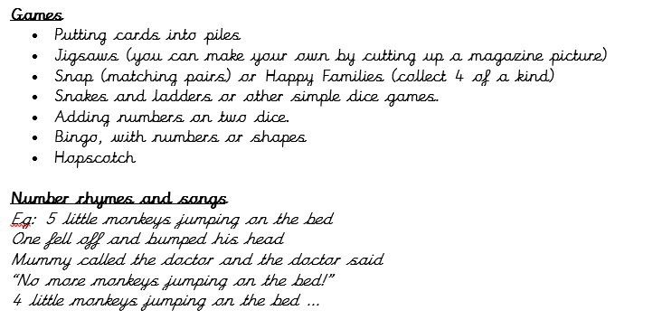
Helping at Home

Slide 14



Any questions? ☺

